Slide 1
REINFORCEMENT LEARNING BASED AUTOMATED PATH PLANNING IN GARDEN ENVIRONMENT USING DEPTH - 'RAPiG-D'
ZEROTH REVIEW
S SATHIYA MURTHI - 2018504604
PRANAV BALAKRISHNAN - 2018504581
C ROSHAN ABRAHAM - 2018504591
BE ELECTRONICS AND COMMUNICATION ENGINEERING
GUIDED BY:​
DR. V. SATHIESH KUMAR,​
ASSISTANT PROFESSOR,
DEPARTMENT OF ELECTRONICS ENGINEERING​
MIT CAMPUS, ANNA UNIVERSITY​

Slide 2
TABLE OF CONTENTS
Introduction
Motivation
Objective
Literature Survey
Methodology
Current Progress
Work plan
References
1

Slide 3
INTRODUCTION
Over the years, robots have been implemented in a wide range of applications and environments.
In turn, this has led to dealing with a host of environments that are increasingly dynamic and unknown.
Path planning with reinforcement learning would aid the automation of multiple tasks with minimal human intervention.
2

Slide 4
MOTIVATION
A learning based approach, can be used to navigate and map an unknown environment and trace the best possible path between any two points.
Stereo camera based depth mapping would be better suited to identify any type of obstacle.
Current methods are limited by their inability to adapt to new environments and varying obstacles.
3

Slide 5
OBJECTIVES
To develop a path finding algorithm that finds the best possible path between two paths in an unknown garden environment.
To perform hardware implementation of reinforcement learning based obstacle mapping and analyze its performance.
To perform detection of plant species using deep learning.
To develop an algorithm to explore all possible paths and determine the most efficient one.
To ensure that the robot avoids all obstacles and unnecessary detours.
4

Slide 6
LITERATURE SURVEY
AUTHOR NAME​ | TITLE​ | YEAR OF PUBLICATION​ | JOURNAL​ | DESCRIPTION​
Qingbiao Li , Fernando Gama , Alejandro Ribeiro , Amanda Prorok | Graph Neural Networks for Decentralized Multi-Robot Path Planning ​ | 2020 | IEEE/RSJ International Conference on Intelligent Robots and Systems | ​This paper proposed a convolutional neural network (CNN) that extracts adequate features from local observations. A graph neural network (GNN) that communicates these features among robots. Model is trained to imitate an expert algorithm and evaluate the method in simulations
5

Slide 7
LITERATURE SURVEY
AUTHOR NAME | TITLE | YEAR OF PUBLICATION | JOURNAL | DESCRIPTION
Martin Gromniak, Jonas Stenzel | Deep Reinforcement Learning for Mobile Robot Navigation | 2019 | Asia-Pacific Conference on Intelligent Robot Systems (ACIRS) | Developed training procedure, set of actions available, suitable state representation, and a reward function. Evaluated using a simulated real-time environment The experimental evaluation showed that DRL can be applied successfully to robot navigation.
6

Slide 8
LITERATURE SURVEY
AUTHOR NAME | TITLE | YEAR OF PUBLICATION | JOURNAL | DESCRIPTION
Jing Xin, Huan Zhao, Ding Liu | Application of Deep Reinforcement Learning in Mobile Robot Path Planning | 2019 | IEEE robotics and automation letters | A Deep Q-network (DQN) is designed and trained to approximate the mobile robot state-action value function and Q value corresponding to each possible mobile robot action is determined by the well trained DQN. The current optimal mobile robot action is selected by the action selection strategy to the goal point while avoiding obstacles ultimately
7

Slide 9
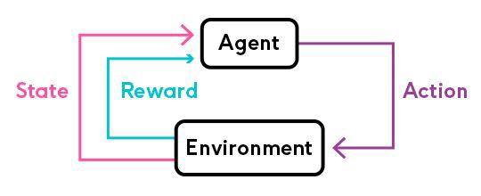
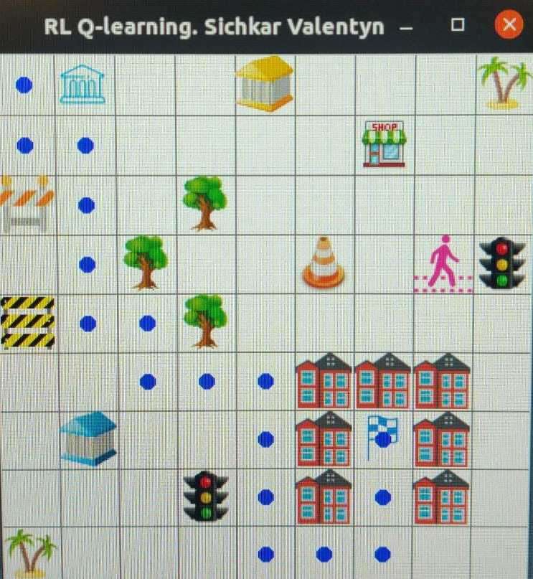
METHODOLOGY
Reinforcement learning is a machine learning training method based on rewarding desired behaviors and/or punishing undesired ones. In general, a reinforcement learning agent is able to perceive and interpret its environment, take actions and learn through trial and error.
Figure2: SARSA – Software Implementation
Figure1: SARSA Illustration
Reference: https://medium.com/@vishnuvijayanpv/what-is-reinforcement-learning-e5dc827c8564
8

Slide 10

METHODOLOGY
Stereo vision is the computation of depth based on the binocular disparity between the images of an object in left and right eyes
The Kinect camera is a motion sensing input device produced by Microsoft and first released in 2010. The device generally contains RGB cameras, and infrared projectors and detectors that map depth through either structured light or time of flight calculations, which can in turn be used to perform real-time gesture recognition and body skeletal detection, among other capabilities.
Image processing techniques are used to extract and utilize the depth map generated.
Figure1: XBOX 360 Kinect camera
Reference: https://en.wikipedia.org/wiki/Kinect
9

Slide 11
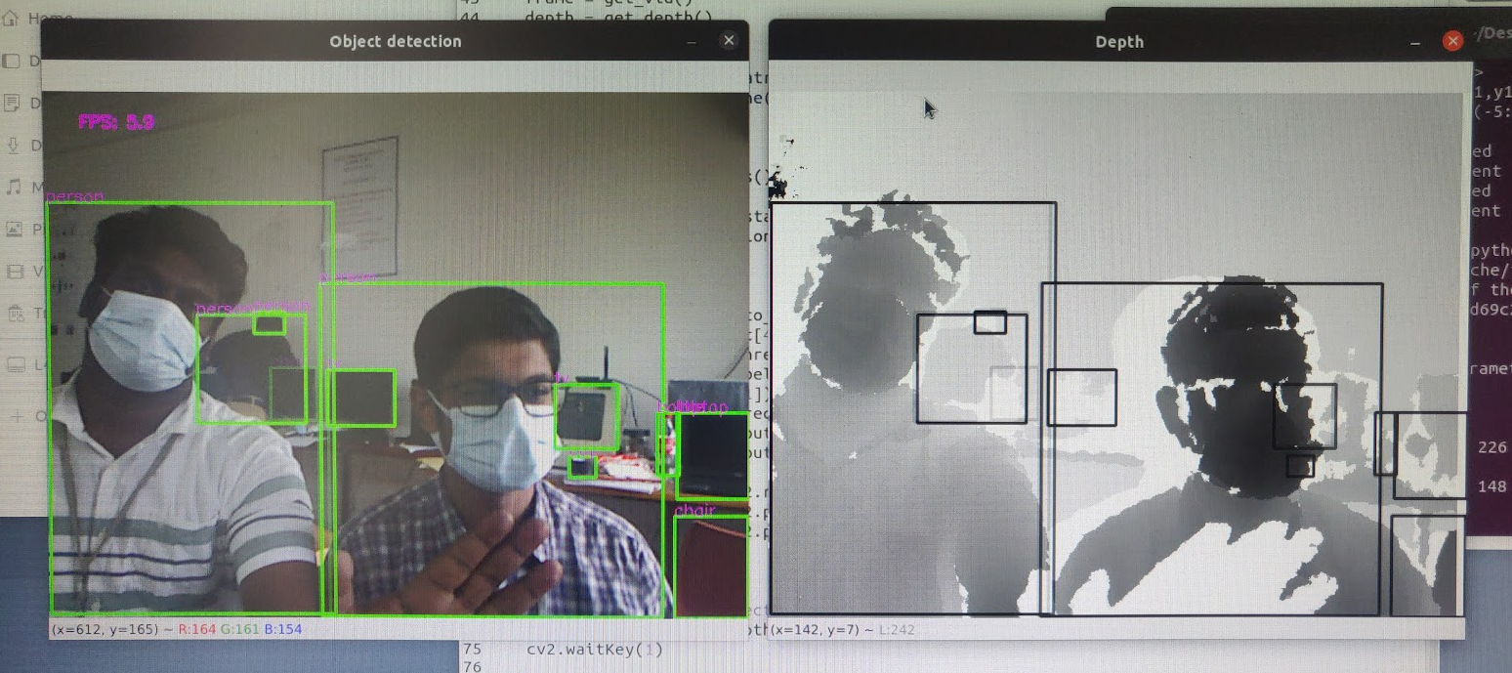
METHODOLOGY
Convolutional neural network (CNN) is a class of deep learning neural networks. They’re most commonly used to analyze visual imagery and are frequently used in image classification.
CNNs can therefore be used to detect and classify plants after collection of suitable dataset.
Models like YOLOv5 can be trained with custom data for the task
10

Slide 12
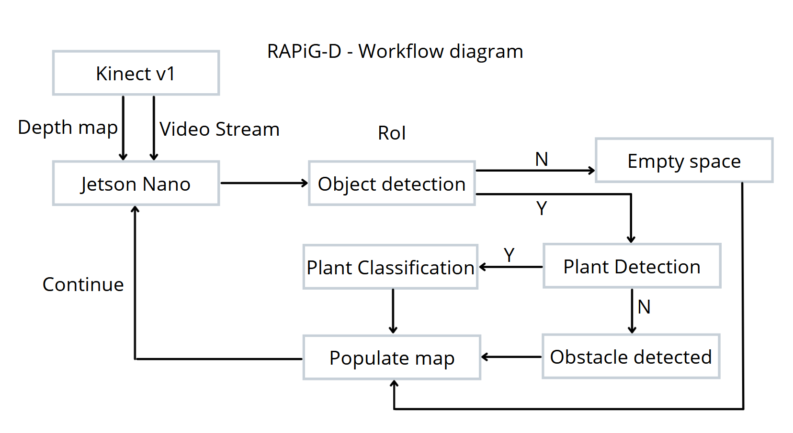
METHODOLOGY
11

Slide 13
COMPONENTS USED
COMPONENTS | SPECIFICATION | NUMBER USED
Jetson Nano | Developer Kit - 4GB | 1
Robot Chassis | Dimensions: 250 x 200 x 46 mm | 1
DC motor | 100 rpm 12V | 2
Wheels | Diameter-130mm Width-60mm | 4
Kinect v1 sensor |  | 1
Motor Driver IC | L298N | 1
IR sensor | 8 channel array | 1
Battery | 12V7A | 1
12

Slide 14
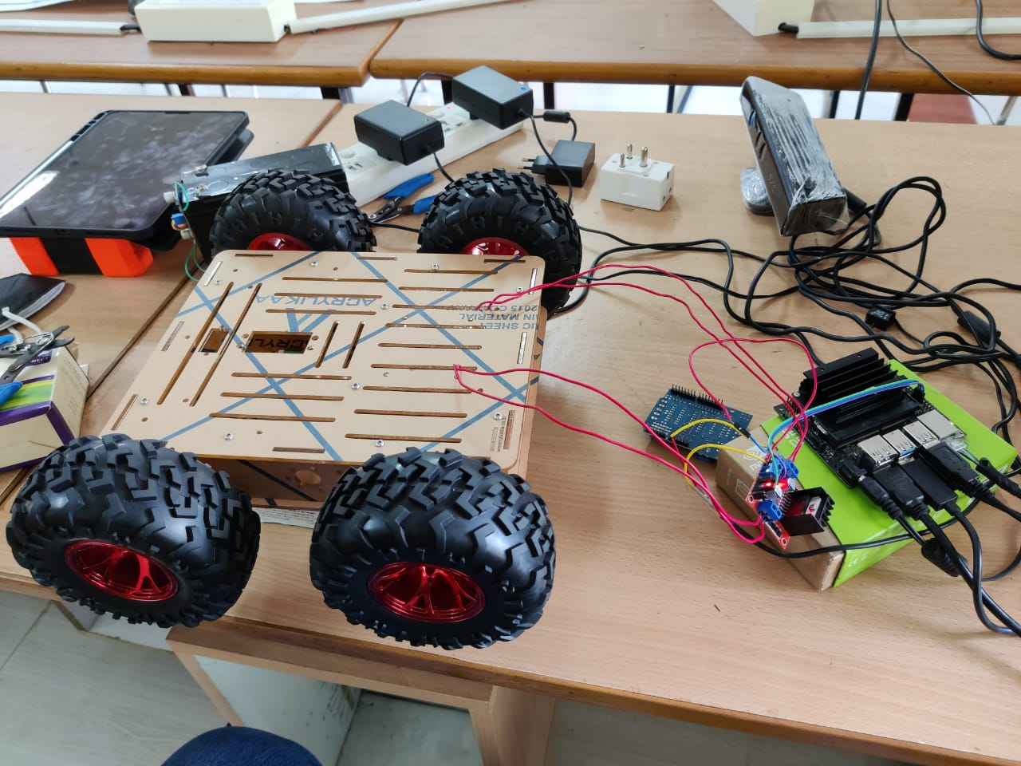
CURRENT PROGRESS
Tested software implementation of RL SARSA in PC.
Explored stereo camera and microcontroller options.
Initialized Jetson NANO and set up bot.
13

Slide 15
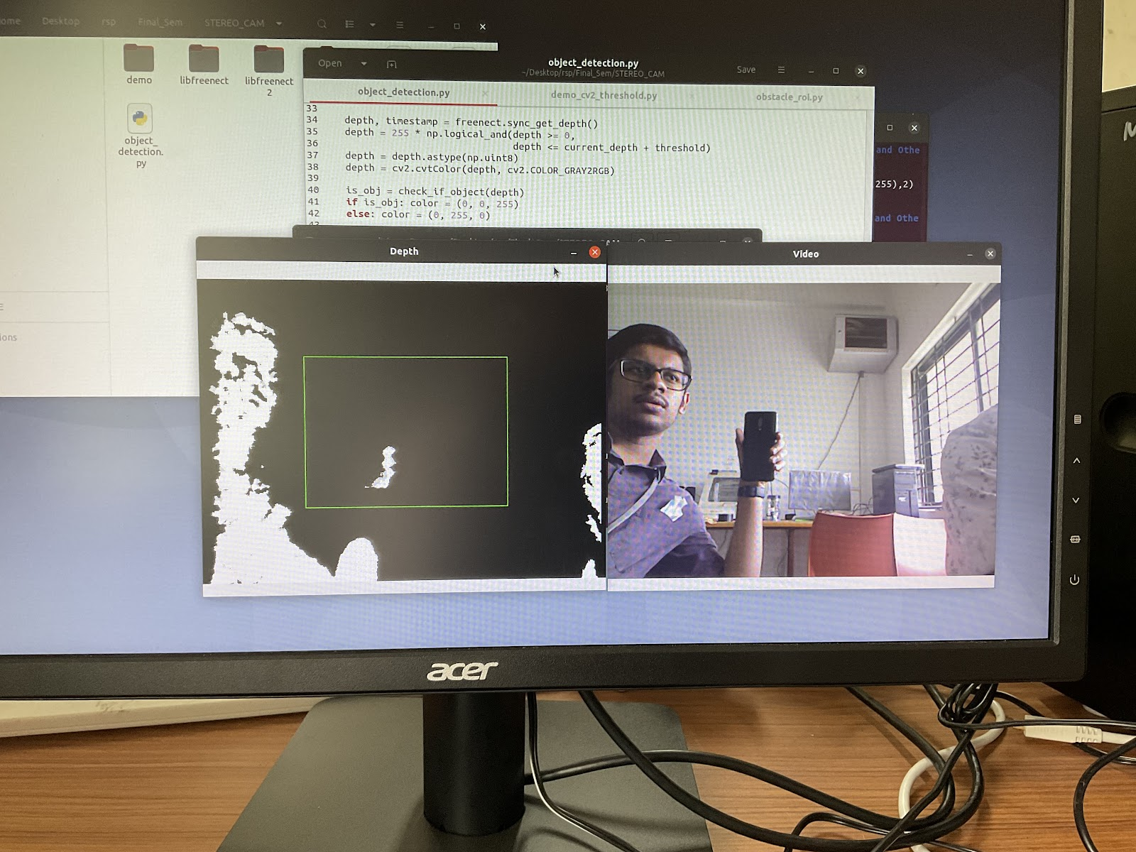
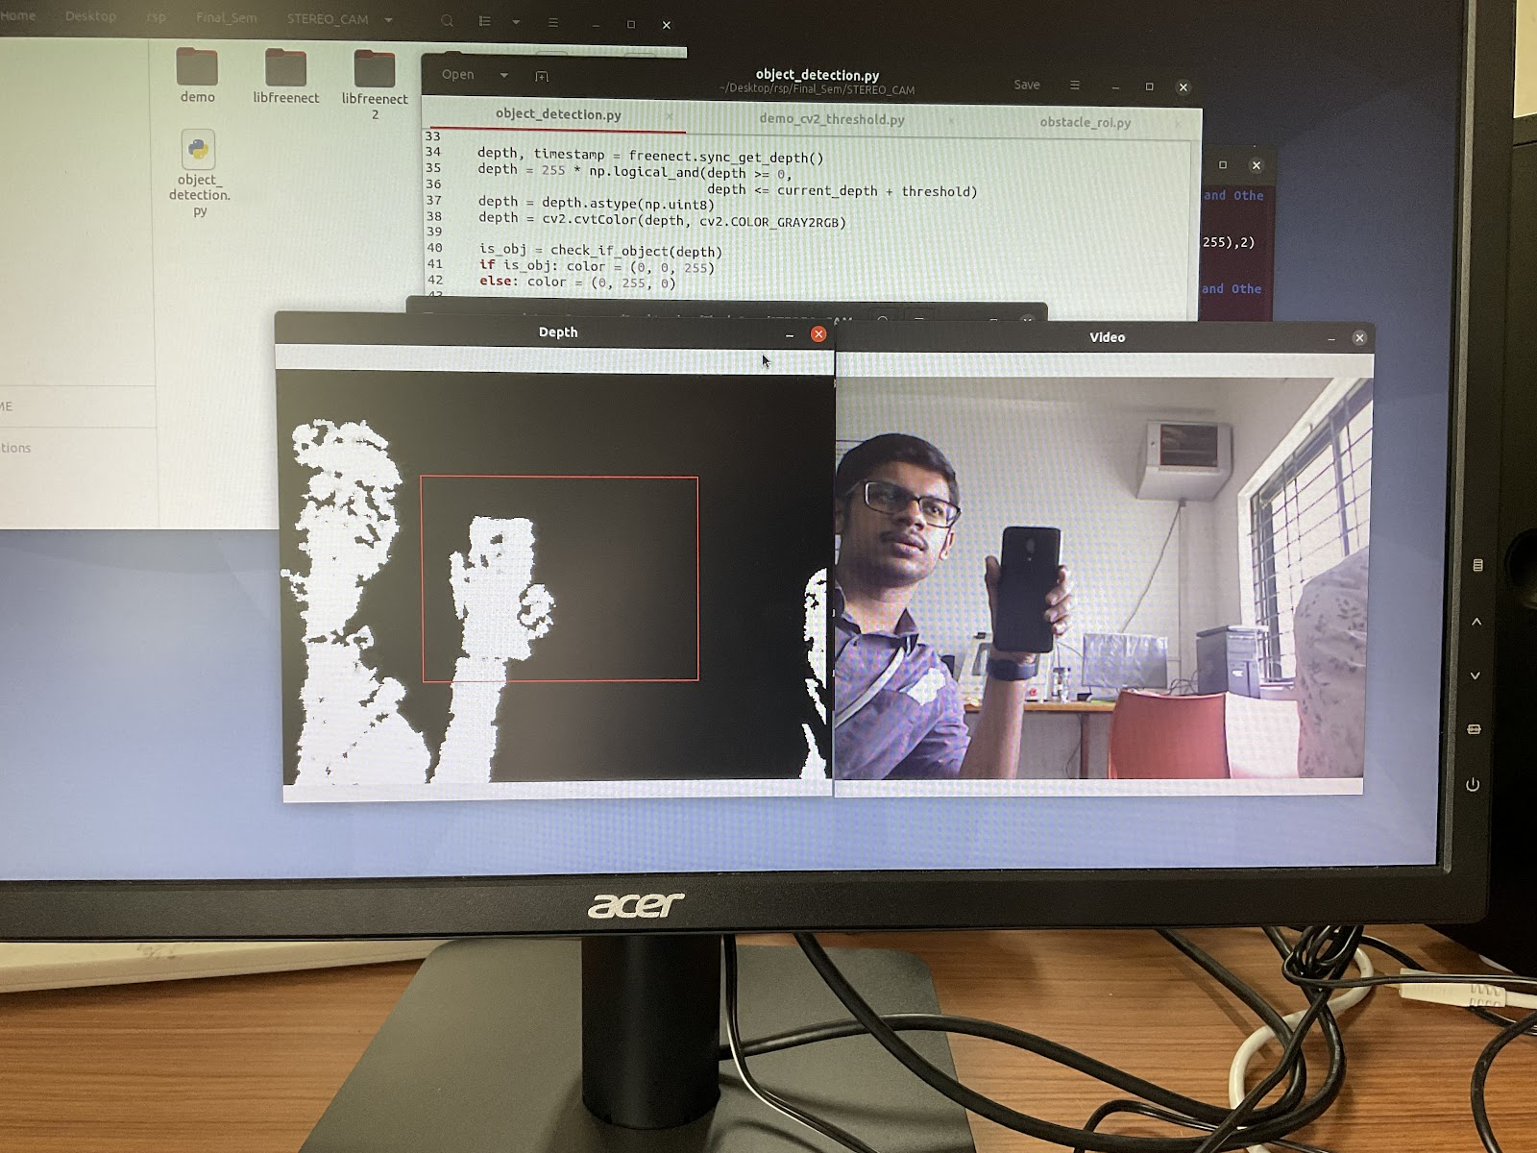
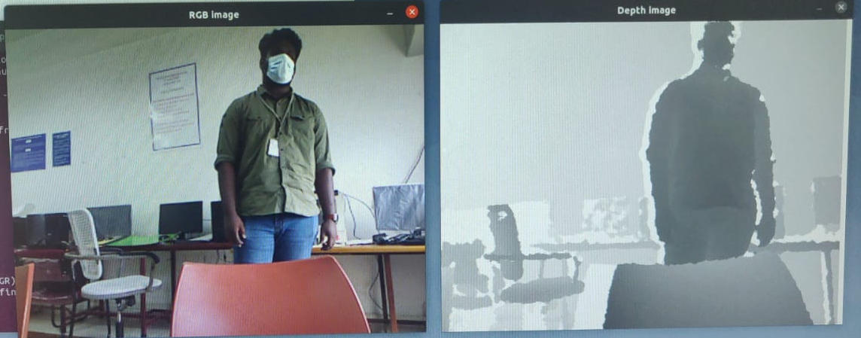
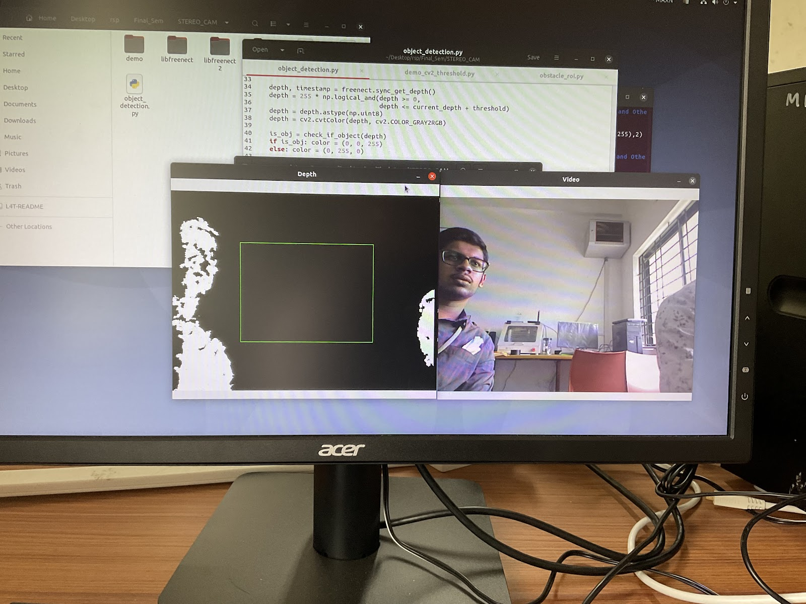
CURRENT PROGRESS
Interfaced with stereo camera (KINECT v1) on Jetson NANO.
Obtained depth map and applied depth threshold to identify nearby objects.
14

Slide 16
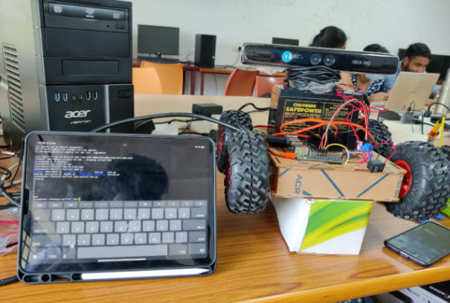
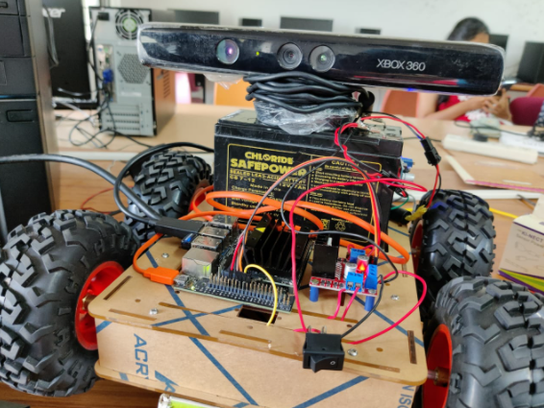
CURRENT PROGRESS
Interfaced with L298N motor driver and enabled four directional movement.
Set up remote access for Jetson NANO using SSH and VNC.
Set up suitable power supply for bot portability.
15

Slide 17
WORK PLAN
First review: Set up testing space. Study available and suitable RL algorithms. Test the performance of the algorithms. | Second Review: Collect data set for plant detection model. Train plant detection model. | Third review: Setup interface for mapping the environment. Testing and optimizing.
16

Slide 18
REFERENCES
Arga Dwi Pambudi,Trihastuti Agustinah and Rusdhianto Effendi,"Reinforcement Point and Fuzzy Input Design of Fuzzy Q-Learning for Mobile Robot Navigation System",International Conference of Artificial Intelligence and Information Technology (ICAIIT),September 2019
Martin Gromniak and Jonas Stenzel ,"Deep Reinforcement Learning for Mobile Robot Navigation", Asia-Pacific Conference on Intelligent Robot Systems (ACIRS),July 2019
Guillaume Sartoretti , Justin Kerr , Yunfei Shi, Glenn Wagner, T. K. Satish Kumar, Sven Koenig, and Howie Choset,“PRIMAL: Pathfinding via Reinforcement and Imitation Multi-Agent Learning”, Ieee robotics and automation letters, , Vol. 4, no. 3, July 2019.
Hyansu Bae , Gidong Kim , Jonguk Kim , Dianwei Qian 4 and Sukgyu Lee , “Multi-Robot Path Planning Method Using Reinforcement Learning”, Multidisciplinary Digital Publishing Institute, Vol 3,No 4, May 2019.
Jing Xin,Huan Zhao,Ding Liu,”Application of Deep Reinforcement Learning in Mobile Robot Path Planning”, Ieee robotics and automation letters, Vol 2, No 3 , January 2019.
17

Slide 19
END OF PRESENTATION

Slide 20
REINFORCEMENT LEARNING BASED AUTOMATED PATH PLANNING IN GARDEN ENVIRONMENT USING DEPTH - 'RAPiG-D'
FIRST REVIEW
S SATHIYA MURTHI - 2018504604
PRANAV BALAKRISHNAN - 2018504581
C ROSHAN ABRAHAM - 2018504591
BE ELECTRONICS AND COMMUNICATION ENGINEERING
GUIDED BY:​
DR. V. SATHIESH KUMAR,​
ASSISTANT PROFESSOR,
DEPARTMENT OF ELECTRONICS ENGINEERING​
MIT CAMPUS, ANNA UNIVERSITY​

Slide 21
TABLE OF CONTENTS
Objectives
Methodology / Block Diagram
Previous progress Recap
Bot Components and HW specs
Current Progress
Problems Faced
Work plan
References
1

Slide 22
OBJECTIVES
To perform hardware implementation of reinforcement learning based path planning to generate a map of an unknown environment by employing depth estimation based obstacle detection and analyze its performance.
To estimate the best possible path to reach a given destination.
2

Slide 23
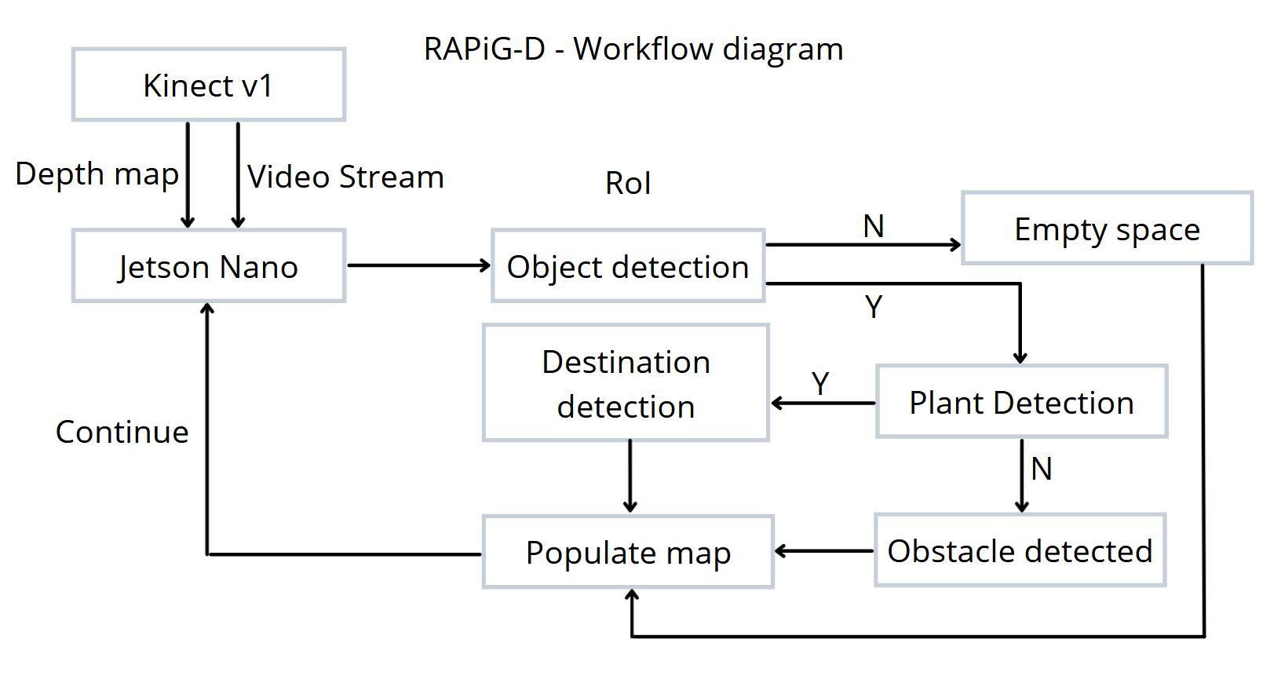
METHODOLOGY
3

Slide 24
PREVIOUS PROGRESS
Tested software implementation of RL SARSA in PC.
Initialised Jetson nano and interfaced with stereo camera (KINECT v1) .
Obtained depth map and applied depth threshold.
Interfaced with L298N motor driver and enabled four directional movement.
Set up basic design of robot.
4

Slide 25
COMPONENTS USED
COMPONENTS | SPECIFICATION | NUMBER USED
Jetson Nano | Developer Kit - 4GB | 1
Robot Chassis | Dimensions: 250 x 200 x 46 mm | 1
DC motor | 100 rpm 12V | 2
Wheels | Diameter-130mm Width-60mm | 4
Kinect v1 Camera | Stereo camera, IR camera | 1
Motor Driver IC | L298N | 1
IR sensor | 8 channel array | 1
Battery | 11.1 V 4200mah Li-Po | 1
6

Slide 26
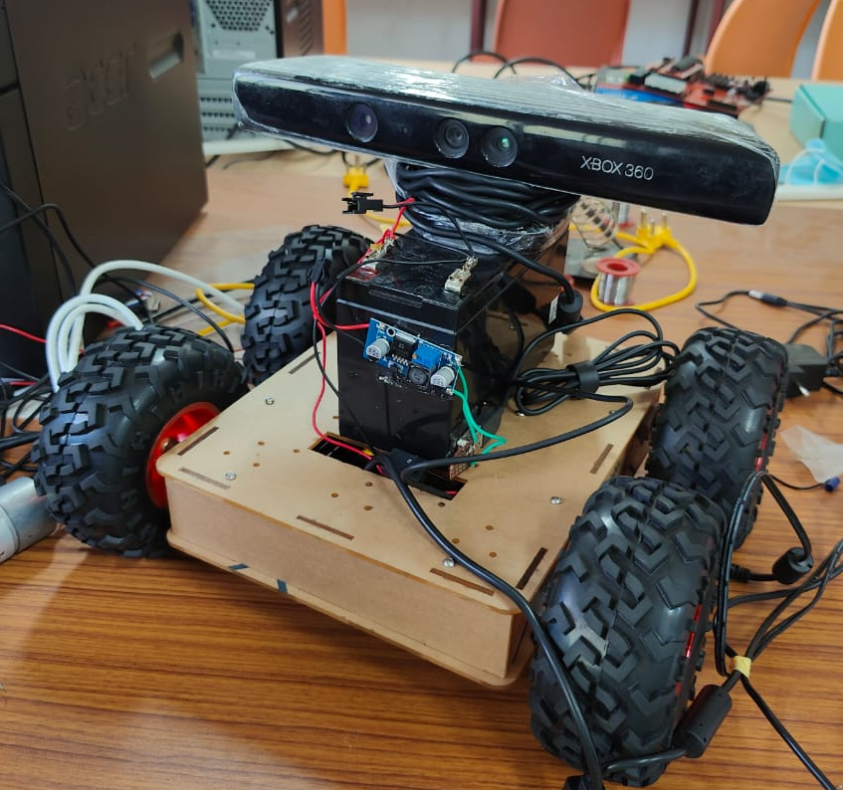
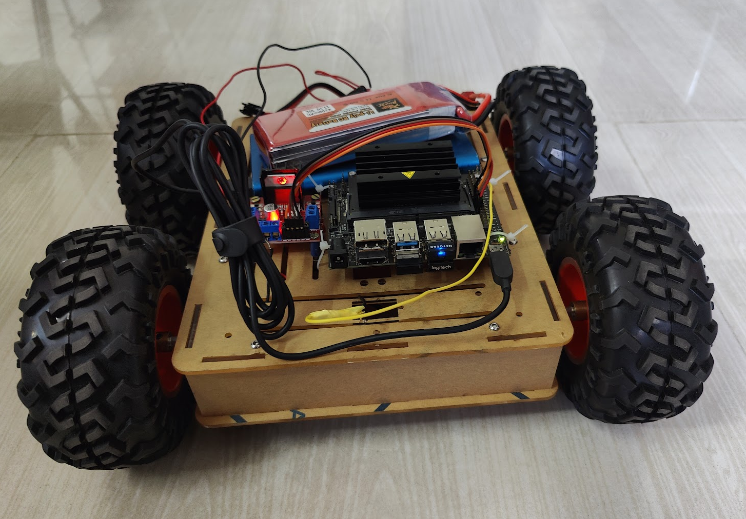
CURRENT PROGRESS
Tried repositioning Jetson nano and motor driver for better weight distribution.
Decided to switch to Li-po battery instead of lead acid 12v battery to power the motor driver.
Set up web output for obstacle detection for remote inference
Tested mono-camera depth estimation using MIDAS model
7

Slide 27
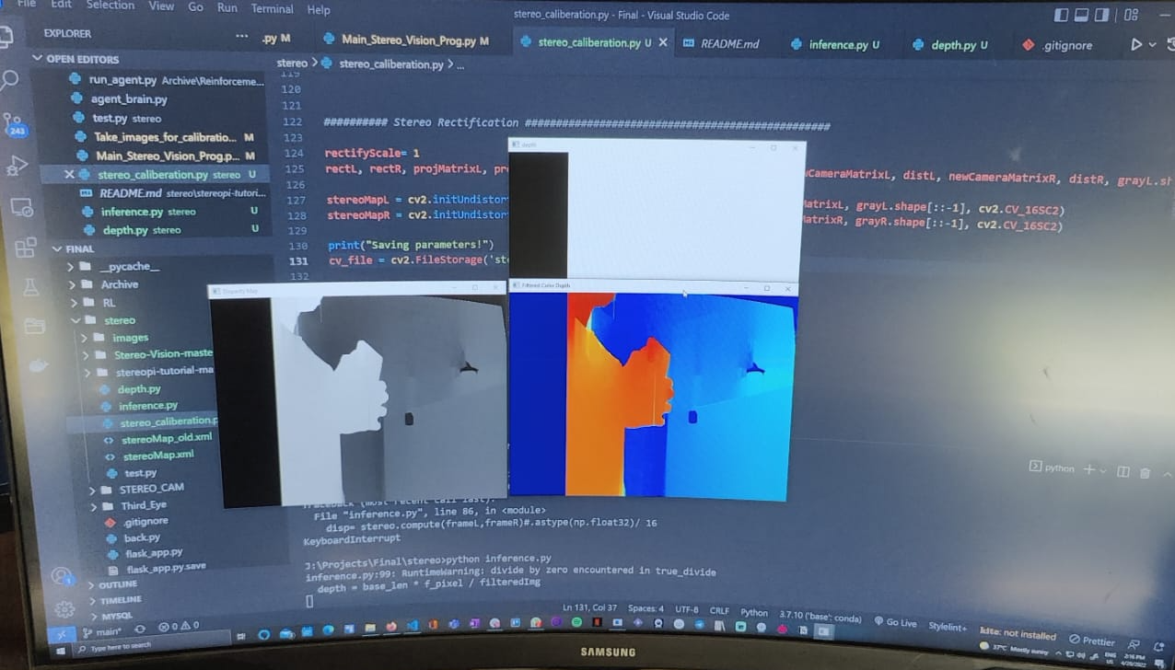
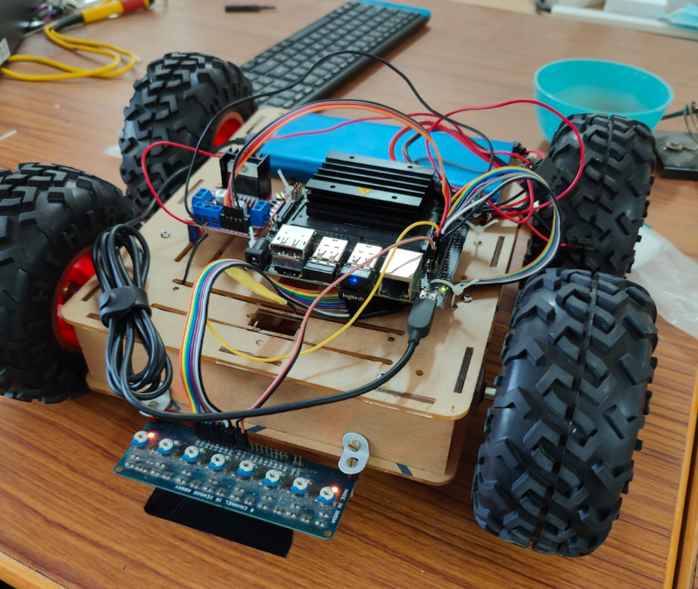
CURRENT PROGRESS
Mounted and used IR sensor array to enable line following for movement calibration. ​
Tested speed control of motor by voltage control using DC-DC converter to improve intersection detection
Implemented stereo camera calibration and depth estimation with two webcams. Performance was not adequate.
8

Slide 28
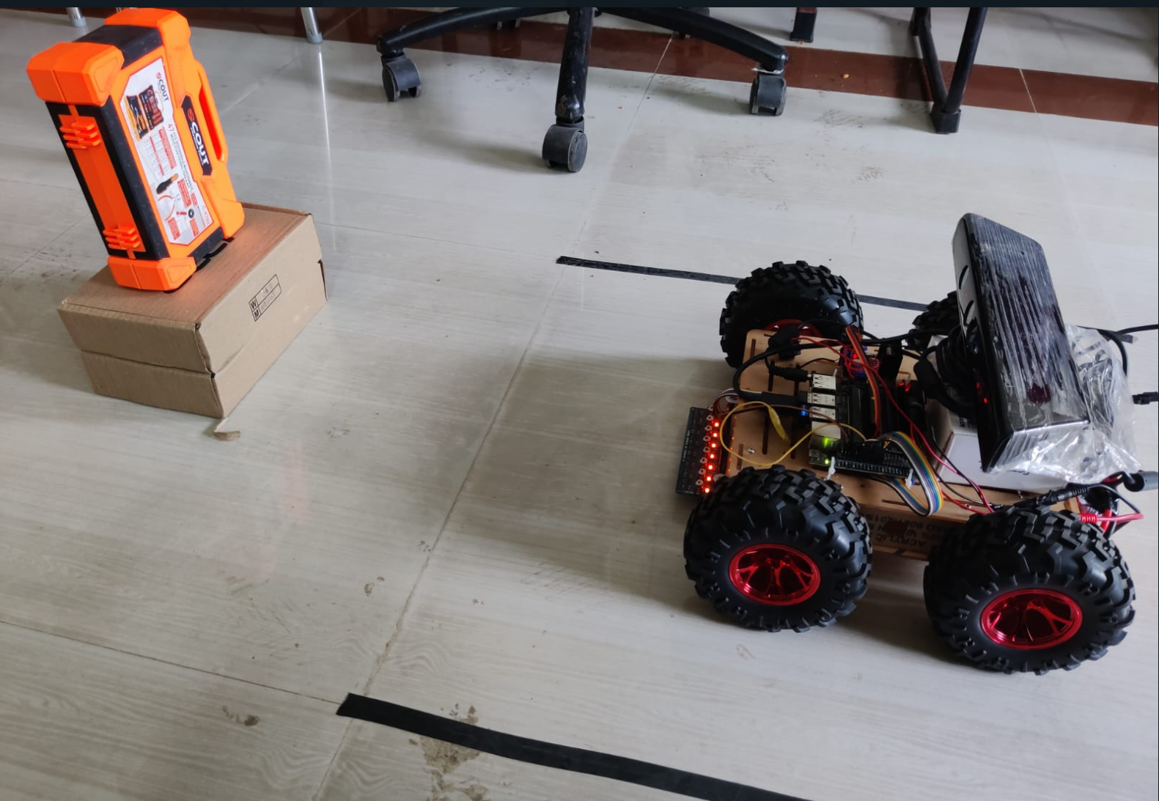
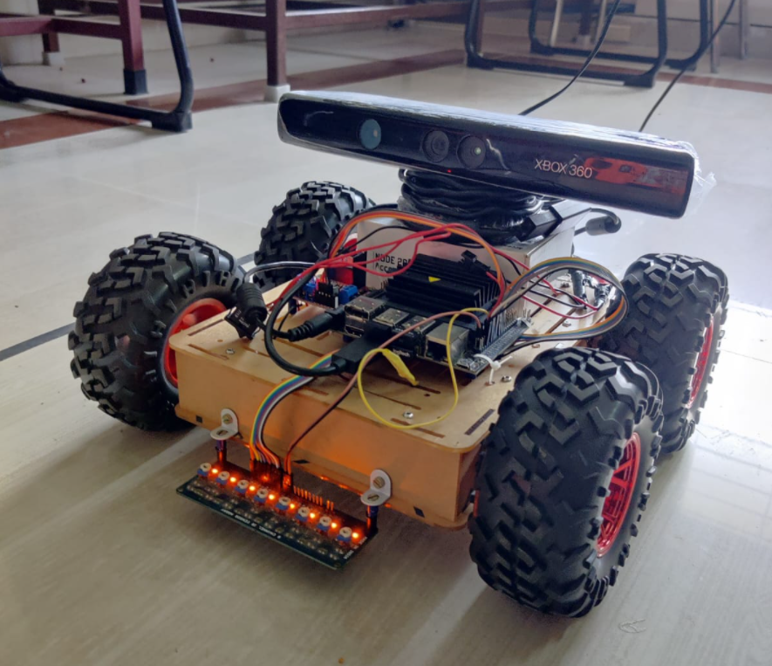
CURRENT PROGRESS
Switched back to Kinect camera
Tested lane detection for movement calibration.
Tried to calibrate turn using line following, timing and detecting line crossing
Optimised object detection to detect obstacles in next cell then integrated it with line following linear movement to set up obstacle mapping in linear space
9

Slide 29
PROBLEMS FACED
Bot movement irregular due to weight and loose shaft
Unable to VNC remotely without display connected. Requires a Dummy HDMI connection.
Jetson nano and Kinect camera not functioning properly when used in battery mode – 12V 7A Lead Acid battery
Stability of bot and calibration is an issue.
Bot doesn’t turn due to the weight of the 12V lead acid battery
Jetson Nano turns off when using Kinect camera when powered by power bank
Bot turning is irregular – Wheels get stuck, skid. Turning inaccurate.
10

Slide 30
WORK PLAN
Second Review: Set up RL algorithm to map 2D space Improve bot stability and calibrate turning | Third review: Setup interface for mapping the environment remotely. Testing and optimizing.
11

Slide 31
REFERENCES
Arga Dwi Pambudi, Trihastuti Agustinah and Rusdhianto Effendi, "Reinforcement Point and Fuzzy Input Design of Fuzzy Q-Learning for Mobile Robot Navigation System",International Conference of Artificial Intelligence and Information Technology (ICAIIT),September 2019
Martin Gromniak and Jonas Stenzel ,"Deep Reinforcement Learning for Mobile Robot Navigation", Asia-Pacific Conference on Intelligent Robot Systems (ACIRS),July 2019
Guillaume Sartoretti , Justin Kerr , Yunfei Shi, Glenn Wagner, T. K. Satish Kumar, Sven Koenig, and Howie Choset,“PRIMAL: Pathfinding via Reinforcement and Imitation Multi-Agent Learning”, Ieee robotics and automation letters, , Vol. 4, no. 3, July 2019.
Hyansu Bae , Gidong Kim , Jonguk Kim , Dianwei Qian 4 and Sukgyu Lee , “Multi-Robot Path Planning Method Using Reinforcement Learning”, Multidisciplinary Digital Publishing Institute, Vol 3,No 4, May 2019.
Jing Xin,Huan Zhao,Ding Liu,”Application of Deep Reinforcement Learning in Mobile Robot Path Planning”, Ieee robotics and automation letters, Vol 2, No 3 , January 2019.
12

Slide 32
END OF PRESENTATION

Slide 33
REINFORCEMENT LEARNING BASED AUTOMATED PATH PLANNING IN GARDEN ENVIRONMENT USING DEPTH - 'RAPiG-D'
SECOND REVIEW
S SATHIYA MURTHI - 2018504604
PRANAV BALAKRISHNAN - 2018504581
C ROSHAN ABRAHAM - 2018504591
BE ELECTRONICS AND COMMUNICATION ENGINEERING
GUIDED BY:​
DR. V. SATHIESH KUMAR,​
ASSISTANT PROFESSOR,
DEPARTMENT OF ELECTRONICS ENGINEERING​
MIT CAMPUS, ANNA UNIVERSITY​

Slide 34
TABLE OF CONTENTS
Objectives
Methodology / Block Diagram
Previous progress Recap
Current robot design
Current Progress
Problems Faced
Work plan
References
1

Slide 35
OBJECTIVES
To perform hardware implementation of reinforcement learning based path planning to generate a map of an unknown environment by employing depth estimation based obstacle detection and analyze its performance.
To estimate the best possible path to reach a given destination.
2

Slide 36
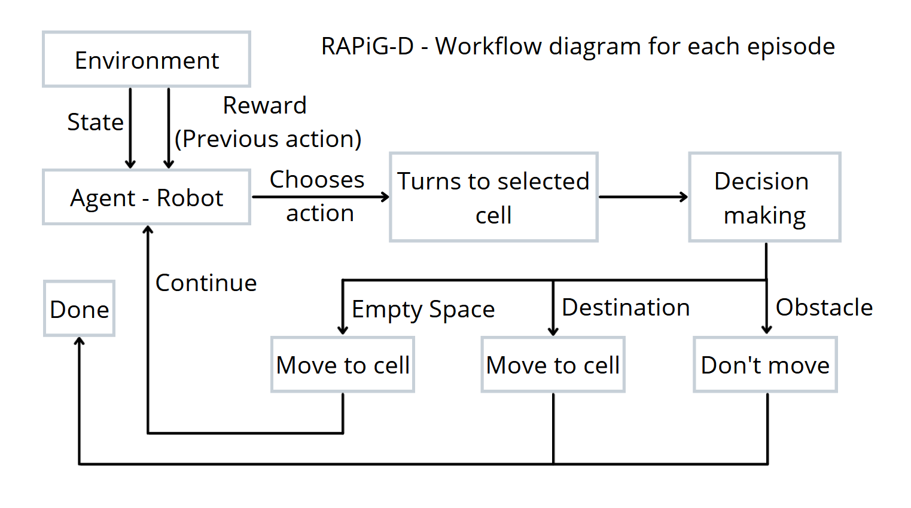
METHODOLOGY
3

Slide 37
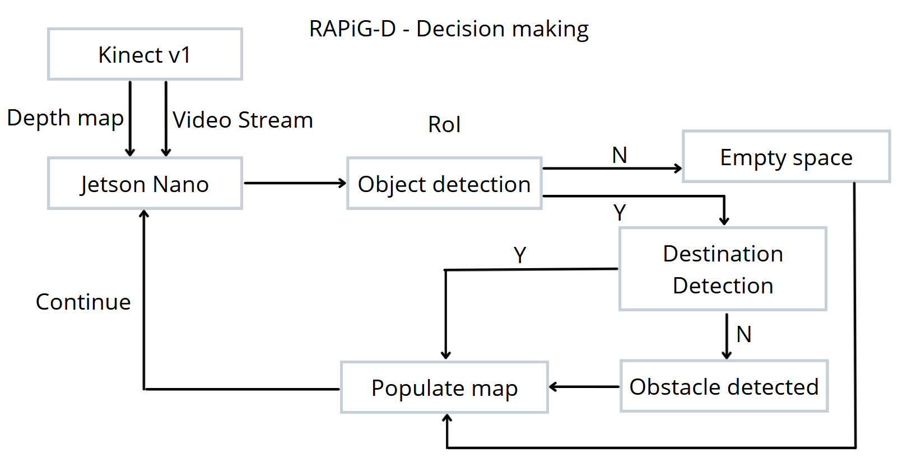
METHODOLOGY
4

Slide 38
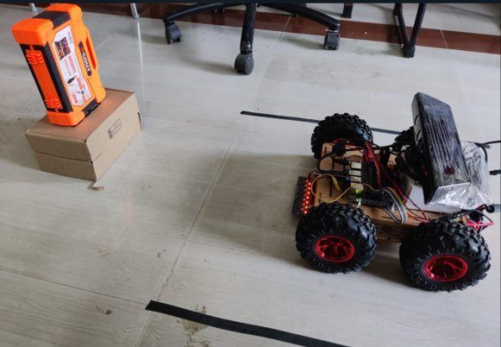
PREVIOUS PROGRESS
Tried options for better weight distribution.
Switched to Li-po battery instead of lead acid 12v battery.
Set up web output for obstacle detection for remote inference
Mounted and used IR sensor array to enable line following for movement calibration.
Tried to calibrate turn using line following, timing and detecting line crossing
Performed mapping of linear space with accurate obstacle detection
5

Slide 39
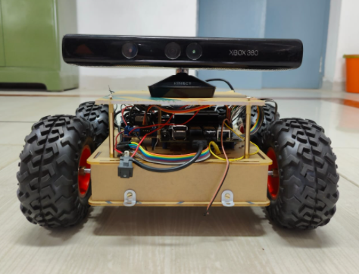
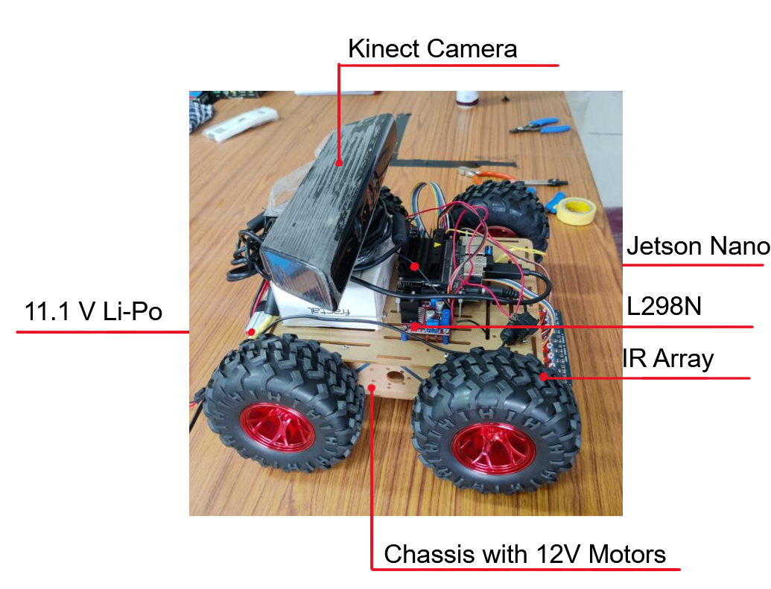
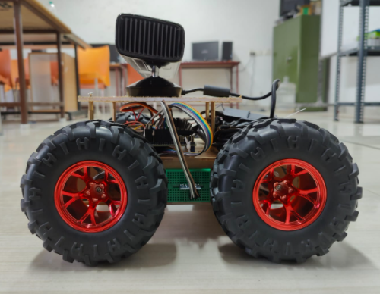
CURRENT BOT
MPU6050
sensor
6

Slide 40
COMPONENTS USED
COMPONENTS | SPECIFICATION | NUMBER USED
Jetson Nano | Developer Kit - 4GB | 1
Robot Chassis | Dimensions: 250 x 200 x 46 mm | 1
DC motor | 100 rpm 12V | 2
Wheels | Diameter-130mm Width-60mm | 4
Kinect v1 Camera | Stereo camera, IR camera | 1
Motor Driver IC | L298N | 1
MPU-6050 | 6 Axis motion tracking | 1
Battery | 11.1 V 4200mah Li-Po | 1
7

Slide 41
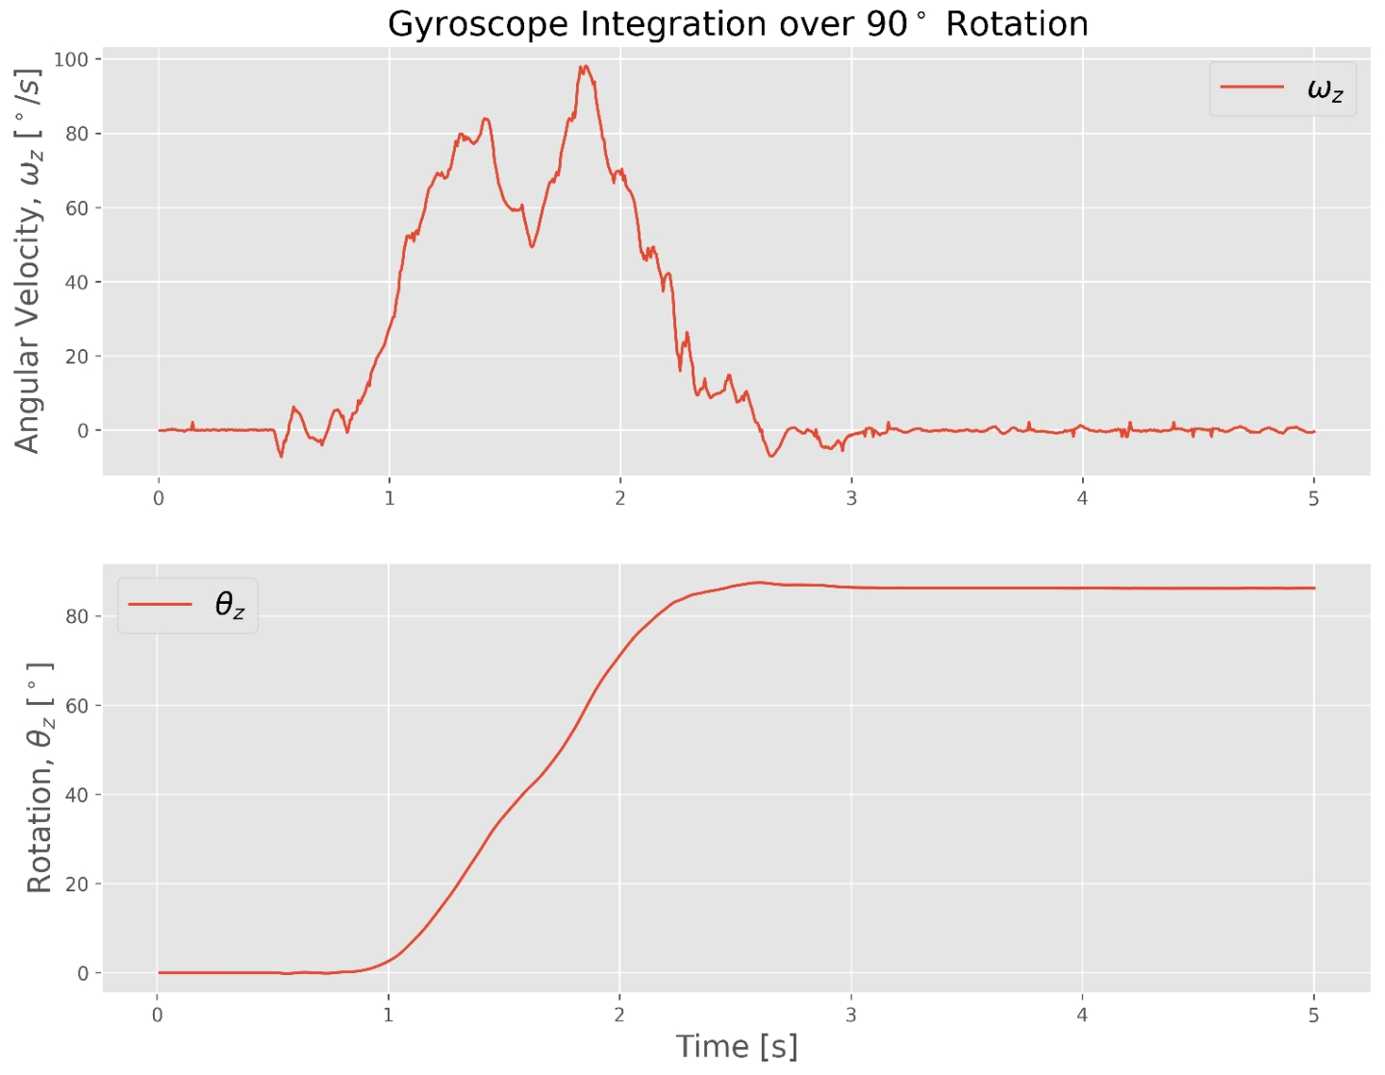
CURRENT PROGRESS
Mounted stage for Kinect camera.
Connected 100RPM 12V motors on all four wheels for better stability.
Interfaced MPU-6050 with jetson nano.
Integrated gyro output (Angular velocity) to get Angular displacement along z-axis which is suitable to identify bot turning.
Used angular displacement destination to accurately turn left and right.
8
Notes:
Modified RL algo to account for obstacles ahead of movement. Facing errors, should try again.
Removed unnecessary turns for invalid locations
Fixed invalid movement out of boundary
Removed warnings
Simulation works well
To check - invalid movement, same location updation, processing, final and complete q-table.

Slide 42
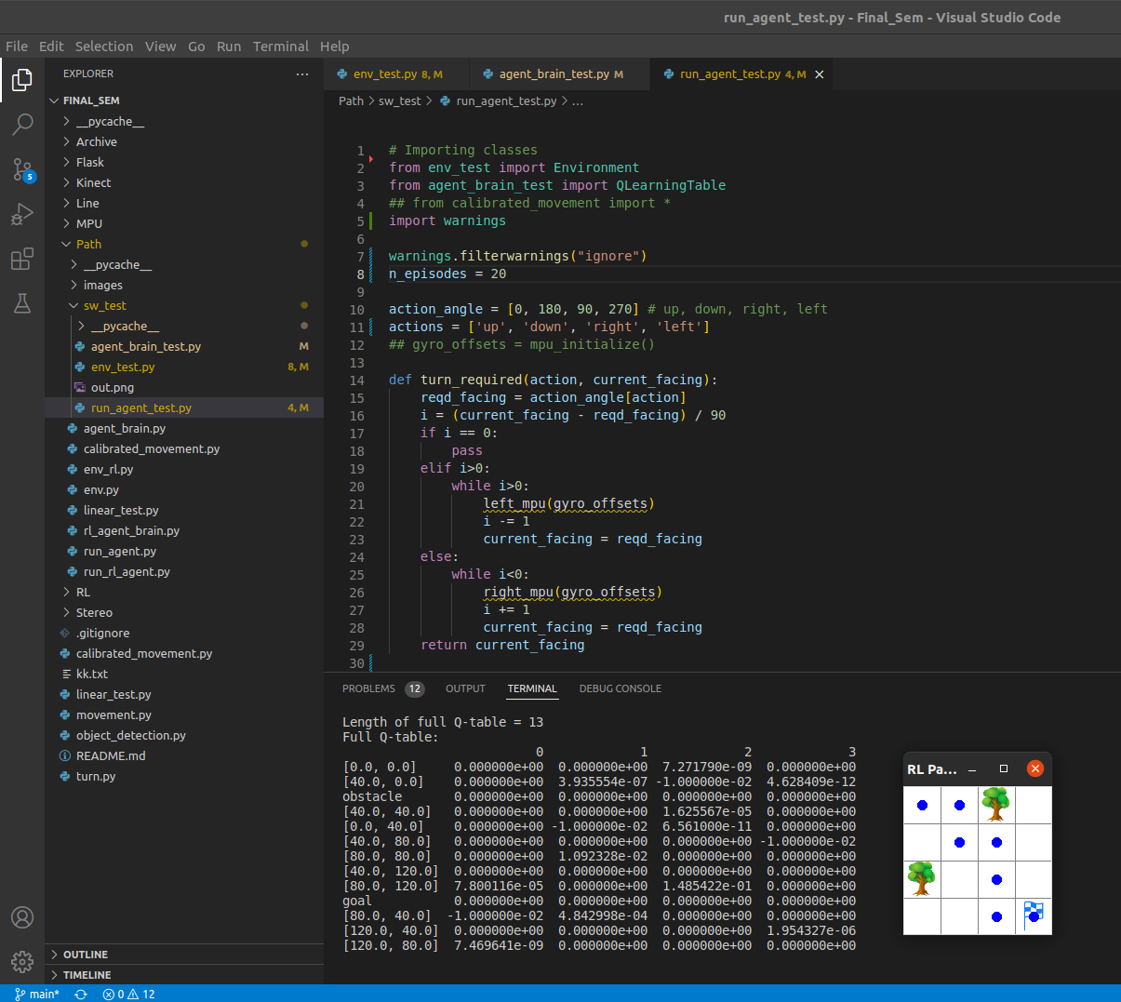
CURRENT PROGRESS
Modified RL SARSA algorithm to make it suitable for hardware implementation by integrating the different modules of obstacle detection, calibrated movement and RL algorithm for path planning.
Tested software simulation of the modified algorithm
Tested the algorithm on a stage atop table with temporary obstacles.
9
Notes:
Ran ten episodes successfully in a 3x3 environment using depth estimation based obstacle detection to detect and populate obstacles.
Bot identified optimal path to destination.

Slide 43
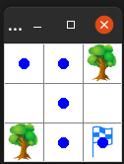
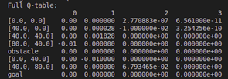
CURRENT PROGRESS
Output of hardware implementation when tested atop table with temporary obstacles.
10

Slide 44
PROBLEMS FACED
Current RL SARSA algorithm was not suitable for hardware implementation
Compatibility issues when integrating the obstacle detection, calibrated movement and RL algorithm for path planning.
Faced errors with processing MPU6050 raw data
Issues with detecting and populating obstacles in map in hardware implementation
11

Slide 45
WORK PLAN
Third review:
Test the validity of hardware implementation in proper testing space.
Setup interface for mapping the environment remotely.
Testing and optimizing.
12

Slide 46
QUESTIONS FROM PREVIOUS REVIEW:
1) Briefly explain your object detection methodology.
Ans: The bot detects objects using stereo vision and depth mapping. The bot detects objects at a distance of 45cm based on the threshold we have set. In order to check whether an object is an actual obstacle, we check if the pixels occupied by an object takes up more than 15% of the area of the pre-defined ROI.
2) Will the bot detect any object in its path?
Ans: Yes, the bot will detect any object in its path as an obstacle. Obstacle detection using depth mapping is very robust as it can detect objects of any shape and size that are at a particular distance from the camera.
3) Explain how you are powering the bot.
Ans: As of now, the four motors are powered by the Li-Poly battery. The Jetson NANO and the Kinect v1 are connected to an AC power source through adapters
13

Slide 47
QUESTIONS FROM PREVIOUS REVIEW:
4) What are the specifications of the motor you are using?
Ans: We are using four motors each rated for 12V and 100rpm.
5) Can the bot be connected to a wifi network?
Ans: Yes, the bot is capable of connecting to a network. We already pass commands to run the bot remotely using SSH.
14

Slide 48
CONFERENCE SUBMITTED
AIKP’22: Second International Conference On Artificial Intelligence and Knowledge Processing Woxsen University Hyderabad, India, July 22-23, 2022
15

Slide 49
REFERENCES
Martin Gromniak and Jonas Stenzel ,"Deep Reinforcement Learning for Mobile Robot Navigation", Asia-Pacific Conference on Intelligent Robot Systems (ACIRS),July 2019
Guillaume Sartoretti , Justin Kerr , Yunfei Shi, Glenn Wagner, T. K. Satish Kumar, Sven Koenig, and Howie Choset,“PRIMAL: Pathfinding via Reinforcement and Imitation Multi-Agent Learning”, Ieee robotics and automation letters, , Vol. 4, no. 3, July 2019.
Hyansu Bae , Gidong Kim , Jonguk Kim , Dianwei Qian 4 and Sukgyu Lee , “Multi-Robot Path Planning Method Using Reinforcement Learning”, Multidisciplinary Digital Publishing Institute, Vol 3,No 4, May 2019.
Jing Xin,Huan Zhao,Ding Liu,”Application of Deep Reinforcement Learning in Mobile Robot Path Planning”, Ieee robotics and automation letters, Vol 2, No 3 , January 2019.
15

Slide 50
END OF PRESENTATION

Slide 51
REINFORCEMENT LEARNING BASED AUTOMATED PATH PLANNING IN GARDEN ENVIRONMENT USING DEPTH - 'RAPiG-D'
THIRD REVIEW
S SATHIYA MURTHI - 2018504604
PRANAV BALAKRISHNAN - 2018504581
C ROSHAN ABRAHAM - 2018504591
BE ELECTRONICS AND COMMUNICATION ENGINEERING
GUIDED BY:​
DR. V. SATHIESH KUMAR,​
ASSISTANT PROFESSOR,
DEPARTMENT OF ELECTRONICS ENGINEERING​
MIT CAMPUS, ANNA UNIVERSITY​

Slide 52
TABLE OF CONTENTS
Objectives
Methodology / Block Diagram
Previous progress Recap
Current robot design
Current Progress
Code / Demo
References
1

Slide 53
OBJECTIVES
To perform hardware implementation of reinforcement learning based path planning to generate a map of an unknown environment by employing depth estimation based obstacle detection and analyze its performance.
To estimate the best possible path to reach a given destination.
2

Slide 54
METHODOLOGY
3

Slide 55
METHODOLOGY
4

Slide 56
PREVIOUS PROGRESS
Calibrated bot movement using MPU 6050.
Modified RL SARSA algorithm to make it suitable for hardware implementation.
Tested software simulation of the modified algorithm
Tested the algorithm on a stage atop table with temporary obstacles.
Output of hardware implementation when tested atop table with temporary obstacles.
5

Slide 57
CURRENT BOT
Kinect v1 Camera
MPU6050
sensor
NVIDIA Jetson Nano
L298N Driver
6

Slide 58
COMPONENTS USED
COMPONENTS | SPECIFICATION | NUMBER USED
Jetson Nano | Developer Kit - 4GB | 1
Robot Chassis | Dimensions: 250 x 200 x 46 mm | 1
DC motor | 100 rpm 12V | 2
Wheels | Diameter-130mm Width-60mm | 4
Kinect v1 Camera | Stereo camera, IR camera | 1
Motor Driver IC | L298N | 1
MPU-6050 | 6 Axis motion tracking | 1
Battery | 11.1 V 4200mah Li-Po | 1
7

Slide 59
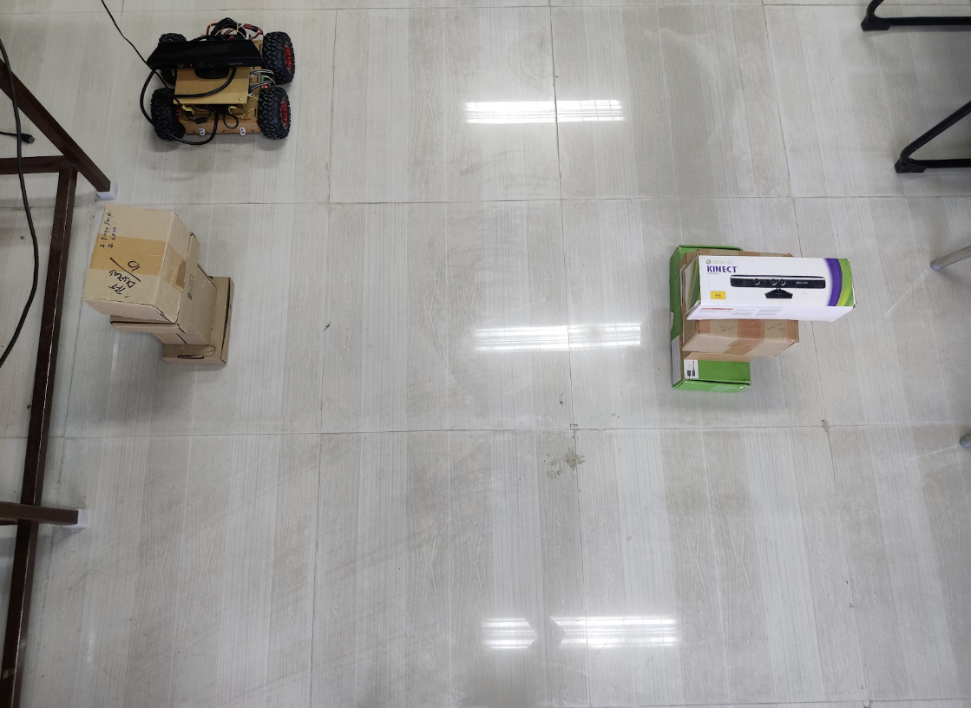
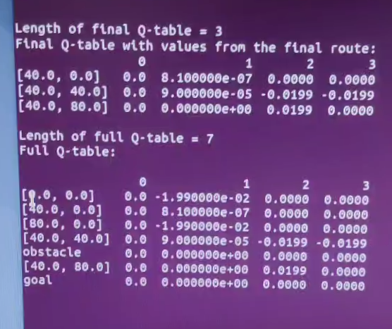
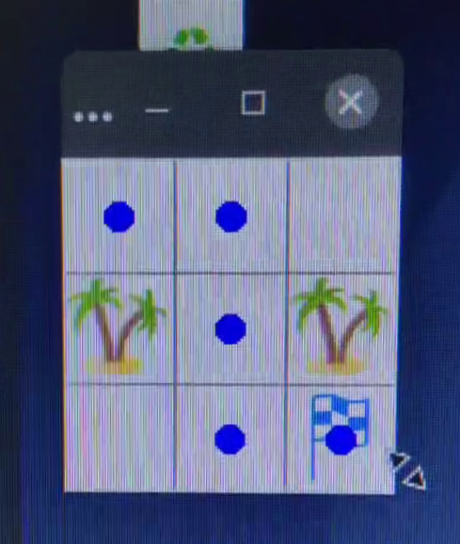
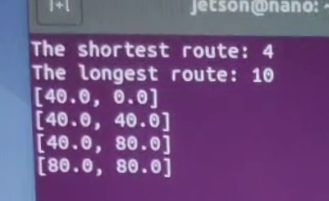
CURRENT PROGRESS
Optimised bot movement.
Performed hardware test in testing space
Set up web app for passing information regarding action chosen in each step.
Performed 2D space mapping in testing space successfully.
Ran 10 episodes on 3x3 space and determined the optimal path.
8

Slide 60
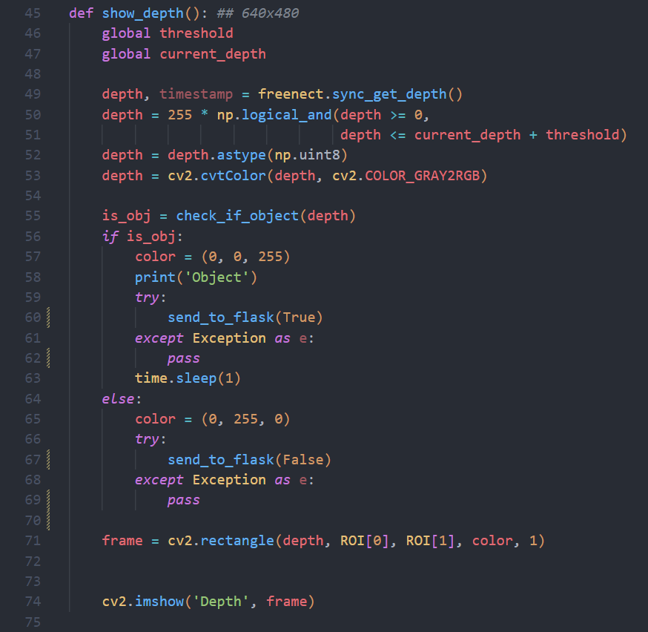
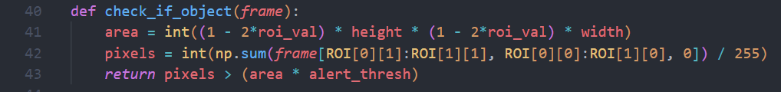
CODE / DEMO – OBSTACLE DETECTION
Libraries used:
Freenect
OpenCV
freenect.sync_get_depth() - Function used to generate depth map
9

Slide 61
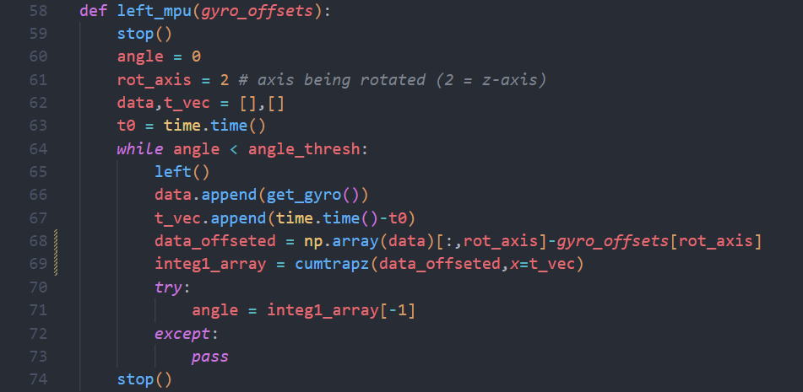
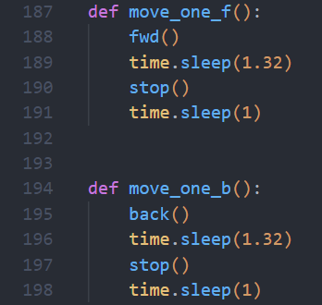
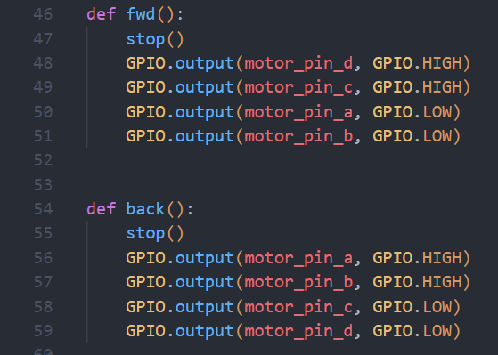
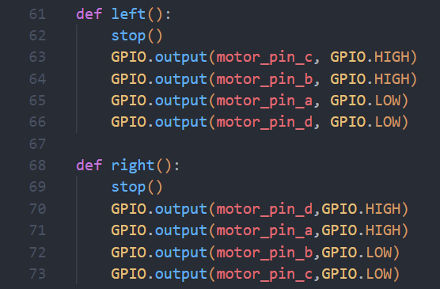
CODE / DEMO – CALIBRATED MOVEMENT
​Turn calibrated using MPU6050 gyro sensor data integration
Linear movement controlled by timing
Motor control using GPIO pins
10

Slide 62
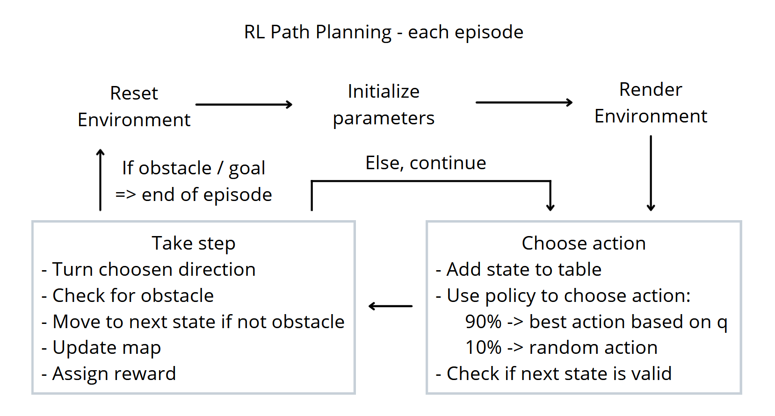
CODE / DEMO – RL PATH PLANNING
11

Slide 63
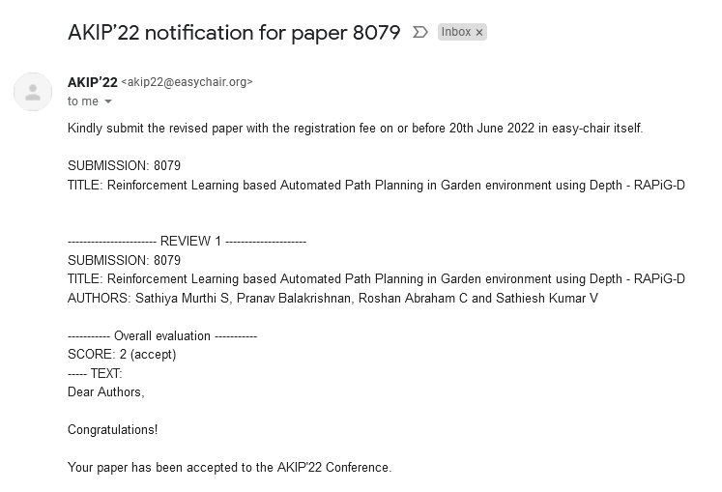
CONFERENCE ACCEPTANCE
​
AIKP’22
Second International Conference On
Artificial Intelligence and Knowledge Processing​ Woxsen University​ Hyderabad, India, July 22-23, 2022​
12

Slide 64
REFERENCES
Martin Gromniak and Jonas Stenzel ,"Deep Reinforcement Learning for Mobile Robot Navigation", Asia-Pacific Conference on Intelligent Robot Systems (ACIRS),July 2019
Guillaume Sartoretti , Justin Kerr , Yunfei Shi, Glenn Wagner, T. K. Satish Kumar, Sven Koenig, and Howie Choset,“PRIMAL: Pathfinding via Reinforcement and Imitation Multi-Agent Learning”, Ieee robotics and automation letters, , Vol. 4, no. 3, July 2019.
Hyansu Bae , Gidong Kim , Jonguk Kim , Dianwei Qian 4 and Sukgyu Lee , “Multi-Robot Path Planning Method Using Reinforcement Learning”, Multidisciplinary Digital Publishing Institute, Vol 3,No 4, May 2019.
Jing Xin,Huan Zhao,Ding Liu,”Application of Deep Reinforcement Learning in Mobile Robot Path Planning”, Ieee robotics and automation letters, Vol 2, No 3 , January 2019.
13

Slide 65
END OF PRESENTATION

Slide 66


REINFORCEMENT LEARNING BASED AUTOMATED PATH PLANNING IN GARDEN ENVIRONMENT USING DEPTH - 'RAPiG-D'
S SATHIYA MURTHI - 2018504604
PRANAV BALAKRISHNAN - 2018504581
C ROSHAN ABRAHAM - 2018504591
BE ELECTRONICS AND COMMUNICATION ENGINEERING
GUIDED BY:​
DR. V. SATHIESH KUMAR,​
ASSISTANT PROFESSOR,
DEPARTMENT OF ELECTRONICS ENGINEERING​
MIT CAMPUS, ANNA UNIVERSITY​

Slide 67
TABLE OF CONTENTS
Introduction
Motivation
Objectives
Literature Survey
Methodology and Flowchart
Results and Discussions
Conclusion
References
1

Slide 68
INTRODUCTION
Over the years, robots have been implemented in a wide range of applications and environments.
In turn, this has led to dealing with a host of environments that are increasingly dynamic and unknown.
Path planning with reinforcement learning would aid the automation of multiple tasks with minimal human intervention.
2

Slide 69
MOTIVATION
A learning based approach, can be used to navigate and map an unknown environment and trace the best possible path between any two points.
Stereo camera based depth mapping would be better suited to identify any type of obstacle.
Current methods are limited by their inability to adapt to new environments.
3

Slide 70
OBJECTIVES
To perform hardware implementation of reinforcement learning based path planning to generate a map of an unknown environment by performing depth estimation based obstacle detection and analyze its performance.
To estimate the best possible path to reach a given destination.
4

Slide 71
LITERATURE SURVEY
AUTHOR NAME​ | TITLE​ | YEAR OF PUBLICATION​ | JOURNAL​ | DESCRIPTION​
Valentyn N. Sichkar | Reinforcement Learning Algorithms in Global Path Planning for Mobile Robot ​ | 2019 | International Conference on Industrial Engineering, Applications and Manufacturing (ICIEAM) | ​This paper implemented two Reinforcement learning algorithms – Q-learning and SARSA in a software simulated virtual environment. It analyzed their performance. The algorithm learnt the optimal path to get maximum payoff and reached goal while avoiding obstacles.
5

Slide 72
LITERATURE SURVEY
AUTHOR NAME | TITLE | YEAR OF PUBLICATION | JOURNAL | DESCRIPTION
Martin Gromniak, Jonas Stenzel | Deep Reinforcement Learning for Mobile Robot Navigation | 2019 | Asia-Pacific Conference on Intelligent Robot Systems (ACIRS) | Developed training procedure, set of actions available, suitable state representation, and a reward function. Evaluated using a simulated real-time environment The experimental evaluation showed that DRL can be applied successfully to robot navigation.
6

Slide 73
LITERATURE SURVEY
AUTHOR NAME | TITLE | YEAR OF PUBLICATION | JOURNAL | DESCRIPTION
Jing Xin, Huan Zhao, Ding Liu | Application of Deep Reinforcement Learning in Mobile Robot Path Planning | 2019 | IEEE robotics and automation letters | A Deep Q-network (DQN) is designed and trained to approximate the mobile robot state-action value function and Q value corresponding to each possible mobile robot action is determined by the well trained DQN. The current optimal mobile robot action is selected by the action selection strategy to the goal point while avoiding obstacles ultimately
7

Slide 74
METHODOLOGY - SARSA
Reinforcement learning is a machine learning training method based on rewarding desired behaviors and/or punishing undesired ones. In general, a reinforcement learning agent is able to perceive and interpret its environment, take actions and learn through trial and error.
The SARSA algorithm involves learning the environment by choosing actions at each state using a policy function.
At each state, an action is chosen and then the environment provides the reward for that action along with the next state. Based on the reward, the Q-values are updated in the Q-table.
Figure 1: SARSA Illustration
Reference: https://medium.com/@vishnuvijayanpv/what-is-reinforcement-learning-e5dc827c8564
8

Slide 75
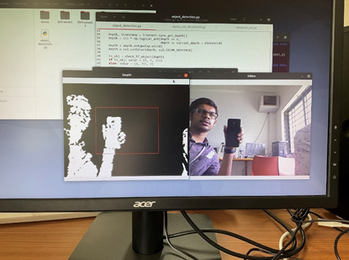
METHODOLOGY - OBSTACLE DETECTION
Stereo vision is used for the computation of depth based on the binocular disparity between the images of an object in left and right eyes.
Stereo Camera based depth estimation is used for detecting obstacles in the testing region
Generated depth map is processed by thresholding to identify objects within a certain distance.
This is then used to detect the presence of obstacles that are large enough in the immediate next cell of the testing space.
Figure 2: Obstacle detection output using stereo camera depth estimation
9

Slide 76
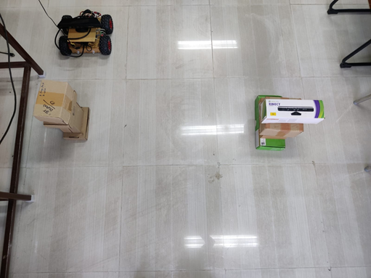
METHODOLOGY – HARDWARE IMPLEMENTATION
To perform hardware implementation, a robot is designed using NVIDIA Jetson Nano Developer Kit as the Micro-controller and XBOX 360 Kinect camera.
The Kinect camera provides the required depth map by utilizing a stereo camera setup along with an IR camera.
An MPU6050 sensor is used to accurately turn by integrating the angular velocity output of the sensor to obtain angular displacement.
A Li-Po battery is used to power four 12V 100 RPM DC motors which are controlled by the L298N motor driver.
The Jetson Nano and the Kinect camera are currently externally powered using a 5V4A AC.
Figure 3: Testing space with robot and obstacles
10

Slide 77
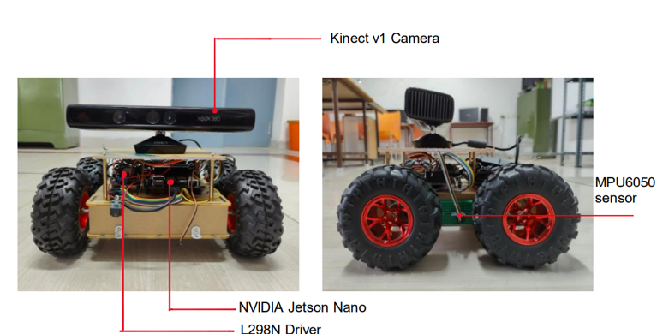
ROBOT DESIGNED
Figure 4: Robot designed for hardware implementation
11

Slide 78
COMPONENTS USED
COMPONENTS | SPECIFICATION | NUMBER USED
Jetson Nano | Developer Kit - 4GB | 1
Robot Chassis | Dimensions: 250 x 200 x 46 mm | 1
DC motor | 100 rpm 12V | 2
Wheels | Diameter-130mm Width-60mm | 4
Kinect v1 Camera | Stereo camera, IR camera | 1
Motor Driver IC | L298N | 1
MPU-6050 | 6 Axis motion tracking | 1
Battery | 11.1 V 4200mah Li-Po | 1
12

Slide 79
FLOWCHART
13

Slide 80
FLOWCHART
14

Slide 81
ALGORITHM
Step 1: Reset environment at start of each episode
Step 2: Choose action at each state based on policy function
Step 3: Check validity of next state
Step 4: Turn to required direction based on action chosen
Step 5: Check next state for presence of obstacle
Step 6: If no obstacle, move to next state and continue
Step 7: Check if new state is the destination given
Step 8: If destination, current route is checked for shortest path from start to destination
Step 9: Each episode ends when either an obstacle is detected or destination is reached and the obstacles are populated in the map
Step 10: A specified number of episodes are run and the agent learns the optimal path and location of obstacles
15

Slide 82
RESULTS AND DISCUSSIONS
To check the validity of the path planning algorithm, software simulation was performed on a larger 10 x 10 environment with 10 obstacles and the agent ran 1000 episodes.
Software implementation takes less time per episode. The start point is (0,0) and the destination is (9,9).
The obstacle coordinates are manually set and fed to the algorithm.
Based on the policy, the RL agent goes around the environment, checking each coordinate to see if it is an obstacle, an empty space, or the destination.
As the episodes progress, the number of steps taken in each episode reduces. This is indicative of the learning process of the agent, allowing it to adapt to the unknown environment after exploring and mapping obstacles and identifying the shortest path to the given destination.
16

Slide 83
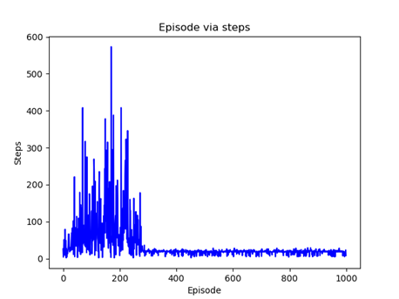
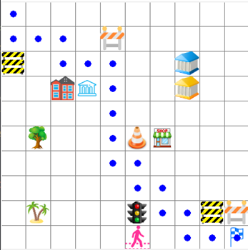
RESULTS AND DISCUSSIONS
Figure 5: Map generated in software implementation
Figure 6: Plot of number of steps in each episode – Software implementation
17

Slide 84
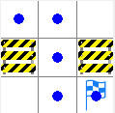
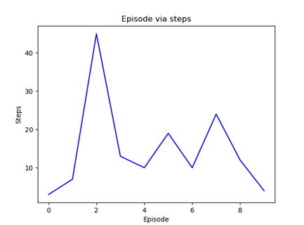
RESULTS AND DISCUSSIONS
The robot agent was allowed to explore a 3 x 3 testing space for 10 episodes.
The starting point is at (0,0) and the destination is at (2,2).
The agent successfully detected obstacles in adjacent cells and populated the detected obstacles as expected.
The movement is also accurate, controlled by the MPU6050 gyro sensor.
After 10 episodes, a map is generated along with the optimal path (Figure 7)
Figure 7: Map generated in hardware implementation
Figure 8: Plot of number of steps in each episode – Hardware implementation
18

Slide 85
RESULTS AND DISCUSSIONS
 | Up | Down | Right | Left
[0.0,0.0] | 0.00 | -0.010000 | 3.615840e-08 | 0.00
Obstacle | 0.00 | 0.000000 | 0.000000e+00 | 0.00
[40.0,0.0] | 0.00 | 0.000008 | 0.000000e+00 | 0.00
[80.0,0.0] | 0.00 | -0.010000 | 0.000000e+00 | 0.00
[40.0,40.0] | 0.00 | 0.000882 | -1.000000e-02 | -0.01
[40.0,80.0] | 0.00 | 0.000000 | 4.900995e-02 | 0.00
[0.0,80.0] | -0.01 | 0.000000 | 2.673090e-04 | 0.00
Goal | 0.00 | 0.000000 | 0.000000e+00 | 0.00
Final Q-Table generated by the RL SARSA algorithm
19

Slide 86
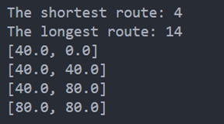
RESULTS AND DISCUSSIONS
Figure 9 shows the shortest path determined by the algorithm.
It is observed that at any given state the Q-value corresponding to an action that would lead to an obstacle in the next state is negative and the action that would allow the agent to move closer to the destination or to the destination itself is positive.
The agent then chooses which action to take at each state and is able to identify the optimal path to reach the destination while avoiding obstacles.
Figure 9: Shorted route and longest route
20

Slide 87
CONCLUSION
The robot as an RL agent, successfully performs RL based path planning to accurately map the environment and its obstacles and determine the shortest path to reach a given destination.
In the 3x3 environment, the robot agent performs accurate obstacle detection implementing depth estimation and by using the SARSA algorithm, identifies the optimal path to the destination within 10 episodes.
As the number of obstacles and the size of the environment increases the time taken to identify the shortest path would also increase.
Thus, a simple RL algorithm such as SARSA is used to identify an optimal path and is able to allow the robot agent to map an unknown environment.
21

Slide 88
FUTURE WORKS
Can be further extended to larger environments and even dynamic environments.
Future implementations may involve increasing the degrees of freedom of the agent and the environment states and even going beyond cell-based environments.
It can also be implemented in diversified applications ranging from garden or warehouse management, Air crash investigations, Search and Rescue operations, serving food at restaurants, and even Space exploration.
22

Slide 89
REFERENCES
Valentyn N. Sichkar, “Reinforcement Learning Algorithms in Global Path Planning for Mobile Robot,” In: International Conference on Industrial Engineering, Applications and Manufacturing, 2019
Martin Gromniak and Jonas Stenzel ,"Deep Reinforcement Learning for Mobile Robot Navigation", Asia-Pacific Conference on Intelligent Robot Systems (ACIRS),July 2019
Guillaume Sartoretti , Justin Kerr , Yunfei Shi, Glenn Wagner, T. K. Satish Kumar, Sven Koenig, and Howie Choset,“PRIMAL: Pathfinding via Reinforcement and Imitation Multi-Agent Learning”, Ieee robotics and automation letters, , Vol. 4, no. 3, July 2019.
Hyansu Bae , Gidong Kim , Jonguk Kim , Dianwei Qian 4 and Sukgyu Lee , “Multi-Robot Path Planning Method Using Reinforcement Learning”, Multidisciplinary Digital Publishing Institute, Vol 3,No 4, May 2019.
Jing Xin,Huan Zhao,Ding Liu,”Application of Deep Reinforcement Learning in Mobile Robot Path Planning”, Ieee robotics and automation letters, Vol 2, No 3 , January 2019.
23

Slide 90
CONFERENCE ACCEPTANCE
​
AIKP’22 - ID: 8079
Second International Conference On
Artificial Intelligence and Knowledge Processing​ Woxsen University​ Hyderabad, India, July 22-23, 2022​
Paper will get published in CRC Press Taylor & Francis Book
24

Slide 91
END OF PRESENTATION

